Slide 1


Aging with Dignity
Supporting Senior citizens in India
Tanvi Avsare (901)
Ajay Gaud (904)
Jesteena Thomas (905)
Mounika Kashi (929)
Anshu Shah (945)
Rahul Prajapati (946)
Sejal Kadu (948)
1

Slide 2






01
Introduction
02
Objectives
03
Research methodology
Context
Data overview
04
Analysis
05
Factor analysis
06
Regression model
07
2
08
Conclusion

Slide 3

Let’s Review
Aging is a natural phase of life, traditionally revered in Indian culture, where elders held key roles in families .
Societal changes now leave many elders facing neglect and loneliness.
Respect, autonomy, and inclusion boost well-being, while government programs offer support but need better implementation.
3

Slide 4





Objectives
To study the relationship of socio-demographic factors and dignity.
To analyze factors affecting the dignity of senior citizens.
To study the impact of government schemes on senior citizens.
To develop a Multiple Linear Regression model to predict the dignity score based on factors influencing dignity.
4

Slide 5









Research Methodology
Data cleaning
tool used
Survey Method
Target Population (60+)
5

Slide 6
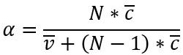

Cronbanch's alpha reliability test
Objective : To check the internal consistency of questions in Questionnaire
Calculation :
Where:
N = number of items = 21
c̅ = mean covariance between items.
v̅ = mean item variance.
α : 0.738
Result : since α value is 0.738 it indicates acceptable internal consistency for the set of items in the scale
6

Slide 7

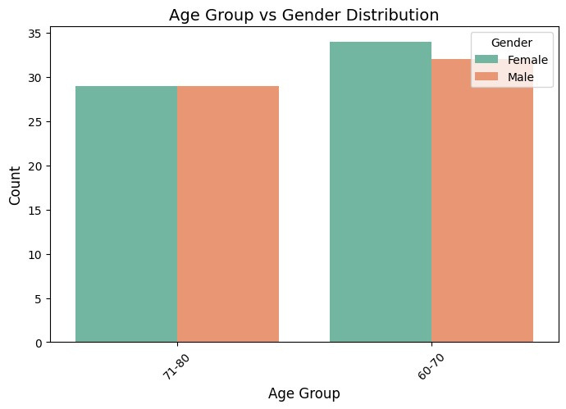
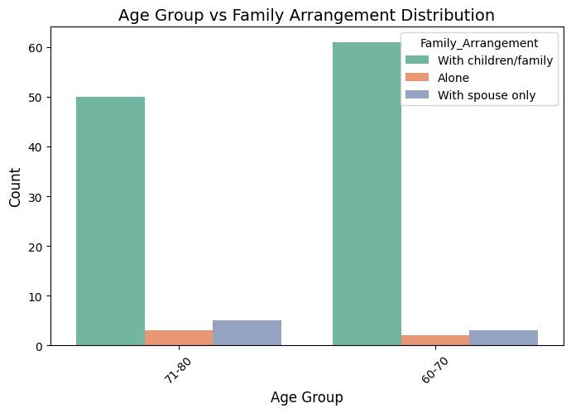
Data Overview
7

Slide 8

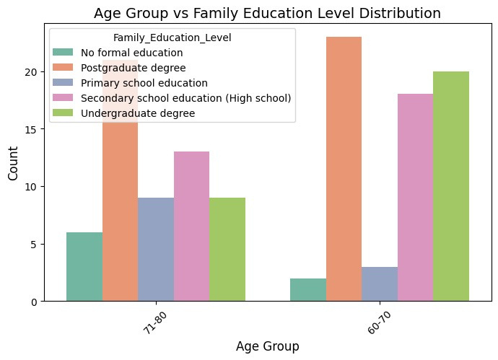
8

Slide 9

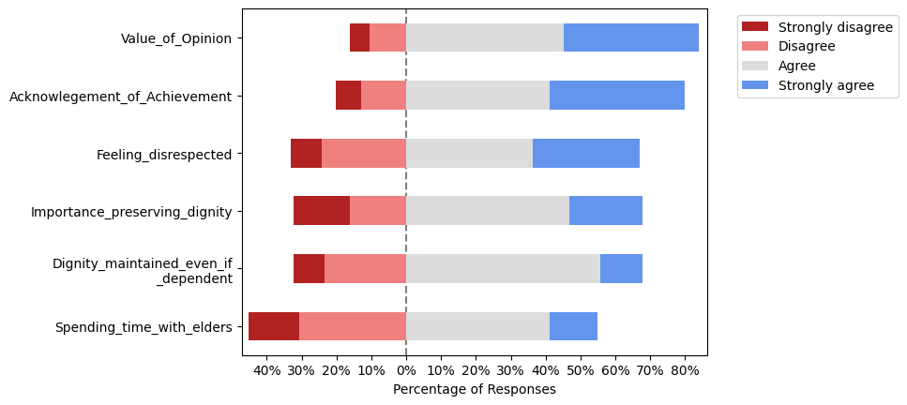
9

Slide 10

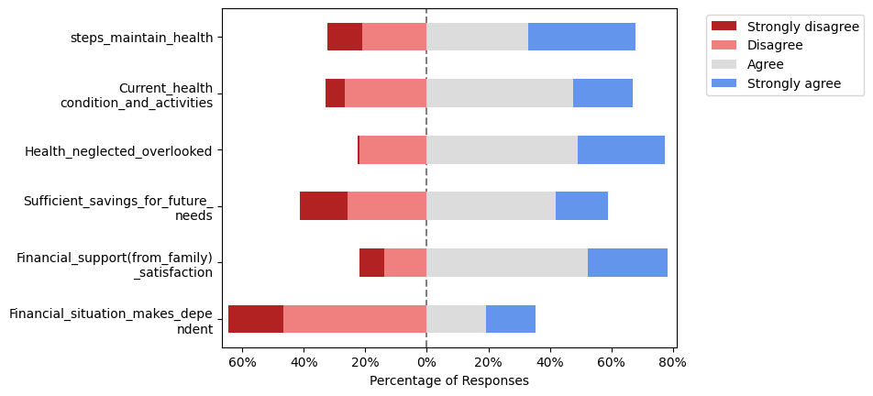
10

Slide 11
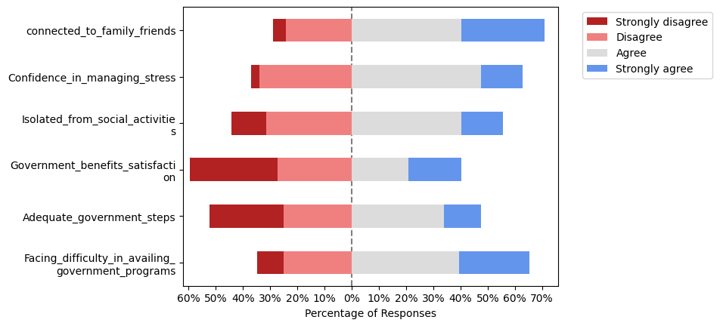
11

Slide 12



Analysis
12

Slide 13
Spearman's rank correlation
Hypothesis:
Null Hypothesis : There is no significant relationship between Family Support and difficulties in availing government benfits
Alternate Hypothesis : There is significant relationship between Family Support and difficulties in availing government benefit
Output:
Spearman's Correlation Coefficient: 0.01545
P-value: 0.88707
Conclusion:
The correlation between the two variables is very weak, and the relationship is not statistically significant.
13

Slide 14

Spearman's rank correlation
Hypothesis:
Null Hypothesis : There is no significant relationship between satisfaction with government programs and stress management confidence
Alternate Hypothesis : There is significant relationship between atisfaction with government programs and stress management confidence
Output:
Spearman's correlation coefficient: 0.045397
p-value: 0.61661
Conclusion:
The correlation between the two variables is very weak, and the relationship is not statistically significant.
14

Slide 15
Mann-Whitney U test
H0: There is no significant difference in perceived support from family between males and females
H1: There is no significant difference in perceived support from family between males and females
Output:
W = 1898.5, p-value = 0.9021
Conclusion:
TSince the p-value is large (0.9021), it suggests that there is no significant difference between males and females in terms of their perceived support from family.
15

Slide 16
Kruskal Wallis Test
Hypothesis:
H0:There is no significant difference Age group and financial support from family.
H1:There is a significant difference age group and financial support from family.
Output:
Test Statistic: 1.87
P-value: 0.17
Conclusion:
Since the p-value (0.17) is greater than the common significance level of 0.05, we fail to reject the null hypothesis (H₀). This means that there is no significant difference in financial satisfaction across the different age groups.
16

Slide 17
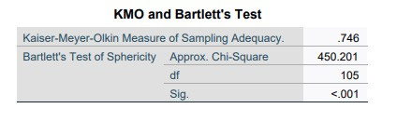

Bartlett’s test
Ho: Correlation matrix is an identity matrix
V/S
H1:Correlation matrix is not an identity matrix
Conclusion:
p≤0.05): Reject H0 Conclude that the dataset is suitable and it is not an Identity matrix.
17

Slide 18

Kaiser -Meyer-Olkin (KMO) test
H0: The sample data is not adequate for factor analysis
H1:The sample data is adequate for factor analysis
KMO value >=0.5 – reject H0
KMO value <0.5 – Accept H0
KMO value- 0.746
conclusion:
As KMO value is more than o.5 we reject H0 and can conclude that the Sample data is adequate for factor analysis.
18

Slide 19

Factor Analysis
Objective: Simplify complex datasets by reducing a large number of variables into a smaller set of meaningful factors
No of independent variables: 15
Dependent Variable: Dignity Score
Since there are 15 variables, to minimize the dimension of MLR a factor analysis is done on those 15 variables .
19

Slide 20
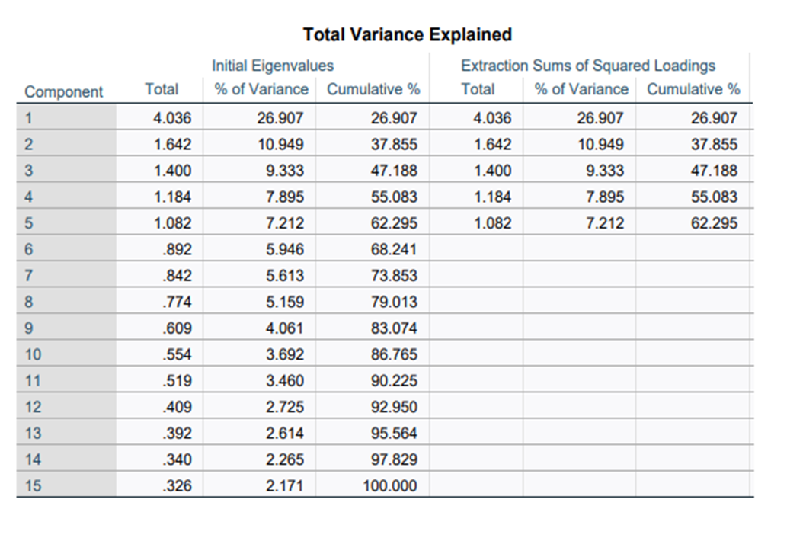


Principal Component Analysis
•Using Kaiser Criterion 5 no of factors are decided to extract
•These 5 factors explains 62.29 % of the data
20

Slide 21
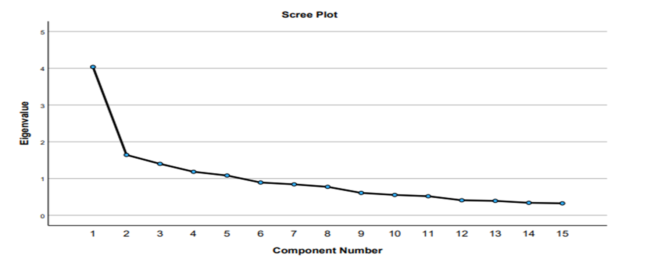
Scree Plot
21

Slide 22
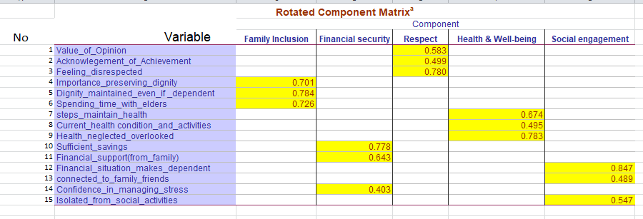
Extracted Components
22

Slide 23

Multiple Linear Regression model
Regression model
•Objective: Develop a predictive model to estimate the Dignity Score using Multiple Linear Regression (MLR).
•Significance: Understanding the key factors influencing dignity can guide effective policies and interventions.
No of independent variables: 5 (after factor analysis)
Dependent variable: Dignity Score
Independent variables names:
1) Family Inclusion
2) Financial security
3) Respect
4) Health & Well-being
5) Social Engagement
23

Slide 24

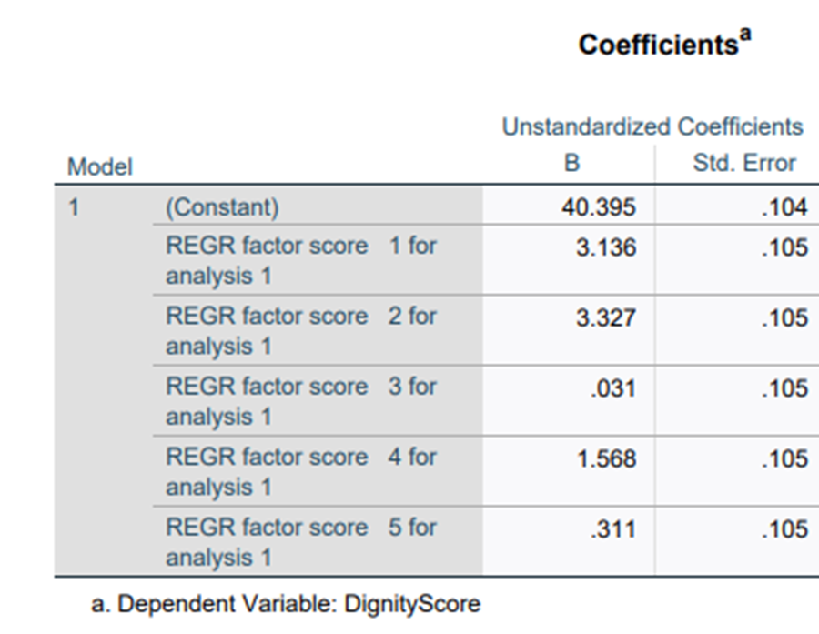

R-square= 0.733
Adjusted R-Square : 0.712
24

Slide 25

Conclusion
Average dignity score for the sample data is 40.39
Gender does not influence the perceived support from family
Financial support received from family is independent of age.
Government Program has no impact on how confident elders feel about managing stress
25

Slide 26


References
https://onlinelibrary.wiley.com/doi/abs/10.1111/jan.12372 https://pmc.ncbi.nlm.nih.gov/articles/PMC8408827/
https://journals.sagepub.com/doi/pdf/10.1177/0095798418771807
https://journals.sagepub.com/doi/10.1177/0969733015617341?icid=int.sj-abstract.citing-articles.53
https://stti.confex.com/stti/congrs15/webprogram/Paper72204.html
https://chj.rums.ac.ir/article_109384.html
26

Slide 27


27

